Slide 1


Undergraduate Science Communication about Culturally Controversial Science Topics
M. Elizabeth Barnes, Ph.D.

Slide 2
Grab a worksheet from your LA and answer this question:
Answer 1: What would you say to someone you know who told you that humans were not causing climate change?
There are no right or wrong answers to the question. I just want your genuine honest response. Take 5 minutes to type your answer to this question. Be as thorough as you can.
Notes:
For copying

Slide 3
What we have learned this semester….
The five core concepts of biology:
  Evolution
  Structure function
  Information flow
  Systems
  Transformation of Energy and Matter
The three unifying theories of biology:
  Evolutionary theory
  Chromosomal theory of inheritance
  Cell Theory
What are we made of? atoms, biomolecules, cells!
How does one cell divide into an entire organism? mitosis!
How do we fight off infections? The immune system!
How are organisms built from DNA? transcription and translation!
Why do we eat and breath? cellular respiration!
How did your genetic parents transfer their genes to you? meiosis!
Why do you resemble your biological parents? genetics and heredity!
How did different species come to be? Evolution!

Slide 4
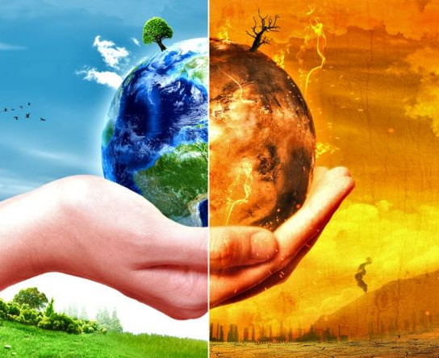
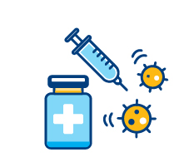
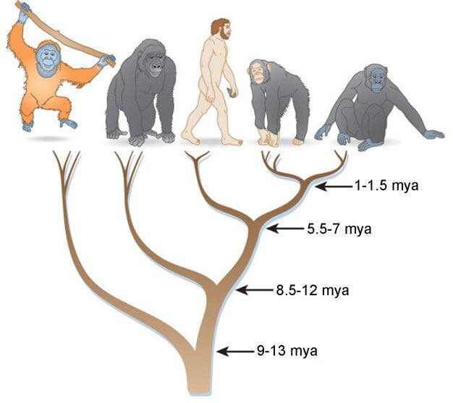
Today: How do we communicate effectively about topics that are controversial but important?
climate change
vaccines
evolution

Slide 5
Learning Objectives
Definitions
Identify culturally controversial science topics and the evidence gathered for the scientific consensus about these topics.
Explain reasons why people reject valid scientific information.
Identify potential negative societal consequences for rejection of valid scientific information.
Explain the potential significance of boundary spanning and cultural competence in science communication.
Explain science communication principles that can help reduce conflict about culturally controversial science topics.
Be able to apply science communication principles in your communication about culturally controversial science topics.
Culturally controversial science topics
Scientific consensus
Dialogue approach
Deficit approach
Boundary spanning
Cultural competence

Slide 6
Culturally Controversial Science Topics (CCSTs)
  When there is broad scientific consensus but significant public disagreement
climate change
vaccines
evolution

Slide 7
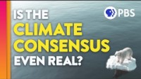
What is scientific consensus? How is it determined?
Guiding questions, answer in your notes:
1. What is scientific consensus?
2. What is peer review and why does this make the scientific consensus even more useful?
3. Why is scientific consensus useful for determining the current most likely scientific truths?
4. What are ways we can measure scientific consensus?
https://www.youtube.com/watch?v=LnnDOMyZjbE&t=1s
Notes:
https://www.youtube.com/watch?v=LnnDOMyZjbE&t=1s (stop at 2:40)

Slide 8
97% of climate scientists agree humans are causing climate change but about 40% of the public disagrees.
98% of biologists believe evolution is the foundation of biology, but about 40% of the public do not think humans evolved.
Most biologists regard vaccines as the greatest public health achievement from science, many people are skeptical.

Slide 9
What causes rejection of scientifically valid information?
Think on your own and write down ideas in your notes
Discuss in groups of 2 -3
climate change
vaccines
evolution

Slide 10
What causes rejection of scientifically valid information?
Sociopolitical messaging from:
Organizations
Politicians
Experiences of discrimination
Perceived Identity Conflict
Unaware of Evidence
Poor public communication from scientists
Unaware of Consensus

Slide 11
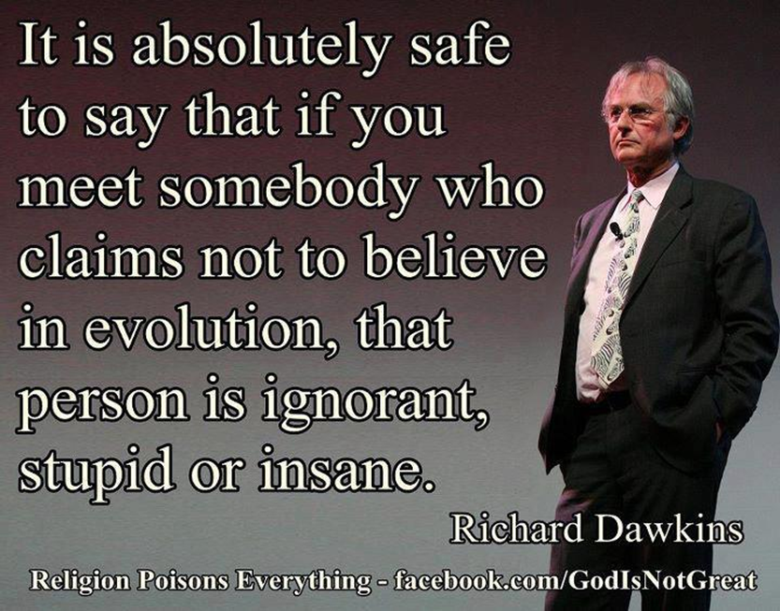
Example of bad science communication about a culturally controversial science topic
Richard Dawkins – evolutionary biologist and former oxford chair for the public understanding of science
Not a good communicator about controversial science topics
Studies show religious folks who know about him are less likely to accept evolution than those that don’t know him and his views
As an atheist, he needs to establish cultural competence with religious groups

Slide 12
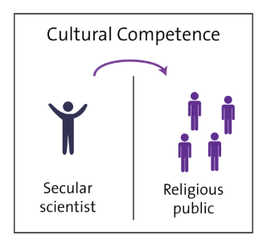
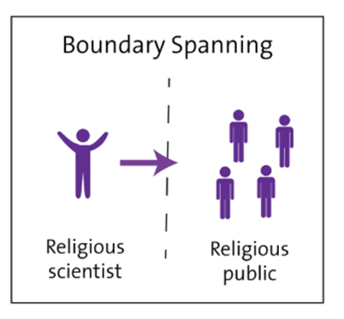
Potential roles of scientists, science educators, healthcare providers in communication about controversial science topics
Cultural competence
The ability of people from one culture to communicate with people from another culture
Boundary spanning
The ability to effectively communicate information between groups due to a shared culture
Scientists who are from different cultures or worldviews than their audience should aim to be culturally competent
Scientists who belong to communities who have tension with science can serve as boundary spanners between the scientific community and their home community.

Slide 13
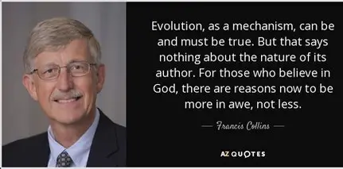
Example of good science communication about culturally controversial science topics
Francis Collins – geneticist and former director of the National Institutes of Health (NIH)
A great communicator about controversial science topics
Studies show religious folks who know about him are more likely to accept science – including evolution and vaccine science
As an evangelical Christian, he is a boundary spanner between science and religion

Slide 14
Consequences of bad science communication…
Lack of meaningful conversation about what to do about climate change because people don’t believe it’s real
Public health crises:
Increases in infectious disease outbreaks due to vaccine hesitancy
Higher mortality rates from pandemics
Lower trust in science – reduces scientists’ ability to use their science to help society.

Slide 15
For which groups in society could you be a boundary spanner about science?
For which groups might you need to develop cultural competence?
Think on your own and write ideas in your notes. You will not share this.
Cultural competence
The ability of people from one culture to communicate with people from another culture
Boundary spanning
The ability to effectively communicate information between groups due to a shared culture
Scientists who are from different cultures or worldviews than their audience should aim to be culturally competent
Scientists who belong to communities who have tension with science can serve as boundary spanners between the scientific community and their home community.

Slide 16
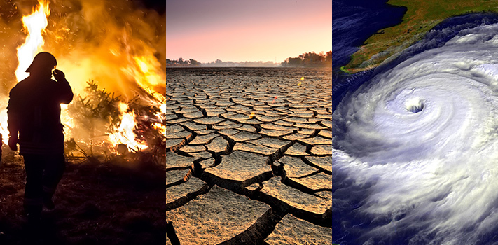
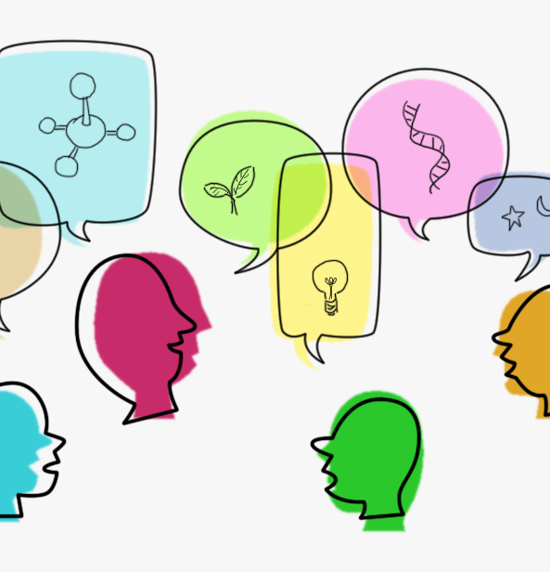
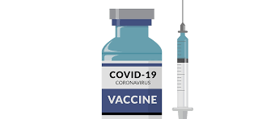
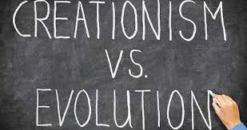
Advancing undergraduate student ability to communicate about culturally controversial science topics
Science communication skills are important for undergraduates
Helps students learn science
Promotes interest in science
Bridges gap between the scientific community and the broader public
Especially important when communicating about culturally controversial science topics.
MTSU Core Learning Outcomes Include: intercultural communication, intercultural awareness, examination of one’s and others’ cultural values
Teaching undergraduate biology students effective science communication strategies can help them establish these skills early in their careers

Slide 17
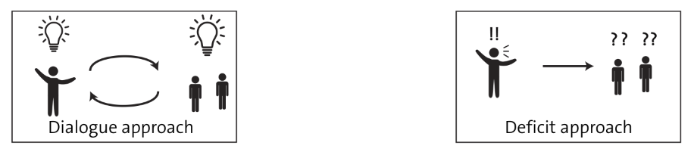
Effective science communication is a two-way street
Scientism
Overemphasizes the authority of science. Presents science as ultimate truth Does not attend to the relationship building.
Dialogic & Inclusive
Engage in two-way conversations about science. Open-minded to diverse perspectives Show curiosity and intellectual humility about science.
Negative Communication
Anger, frustration, accusations, or condescension in communication Accusing the person of being morally unethical.
Avoidance
Disengages from the conversation Avoids conversations with those they disagree with.
Know the audience
Recognize how cultural background can shape perceptions and attitudes. Inquire about why people believe what they do.
Convey respect & shared values
Build trust and establish relationships. Find and focus on agreement (example: we all want our communities to be safe).

Slide 18
What about undergraduate students?
How do they communicate about culturally controversial science topics?
Do they take a deficit approach, or do they use effective science communication principles?
Dialogic & Inclusive
Curiosity Get to know the other person’s perspective Be respectful Find common ground
Deficit
Scientific facts only Negative communication Accusations Avoidance

Slide 19
Studies exploring undergraduate biology students’ current CCST communication experiences
Vaccine Communication
Climate Change Communication
Variables explored:
Communication frequency
Communication strategies
Communication education experiences
Methods used:
+
Surveys
Interviews

Slide 20
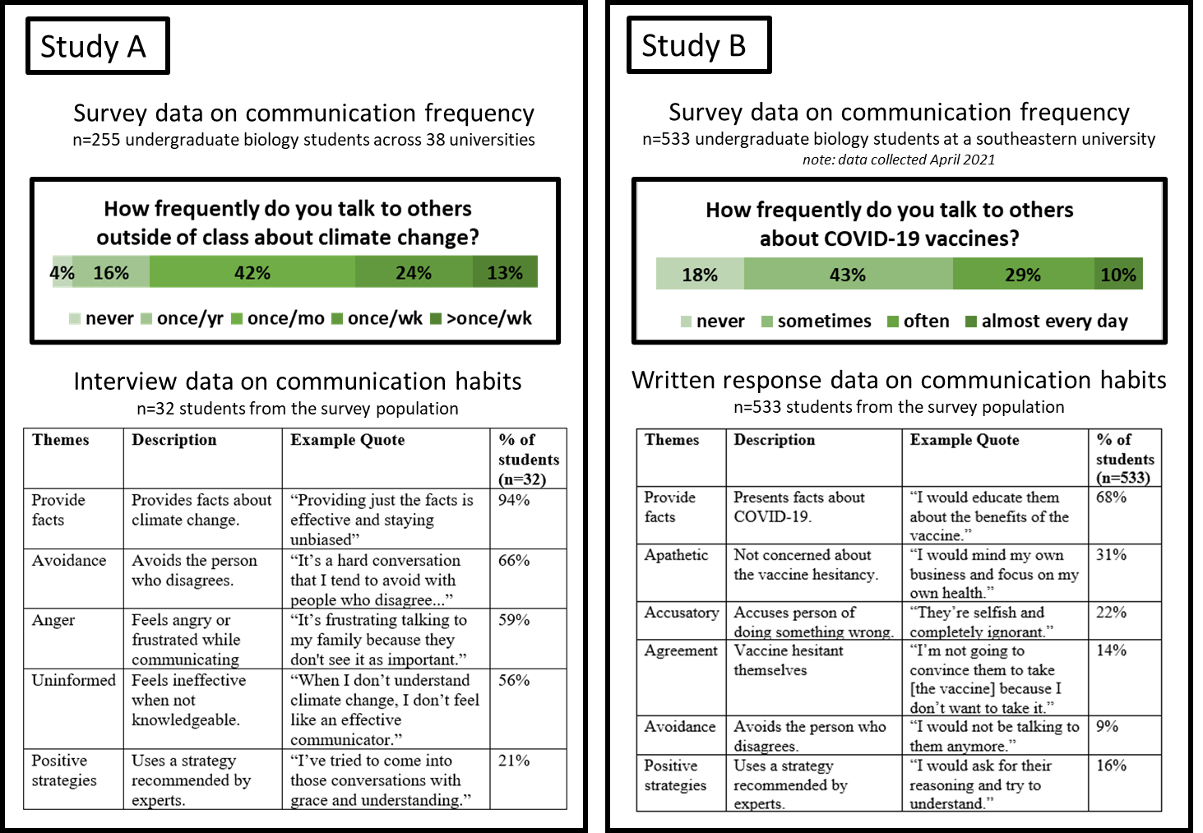
Finding 1: Students are already science communicators about controversial topics
COVID-19 Vaccine Communication
Climate Change Communication
surveys
533 MTSU
biology students
255 biology students
38 universities
*data collected April 2021
Couch et al., 2022 Frontiers in Education
Bowen et al., 2025 CBE Life Sciences Education

Slide 21
Finding 2: Students report using strategies that are ineffective for reducing conflict
COVID-19 Vaccine Communication
What would you say to a friend or family member who did not want to get the COVID-19 vaccine?
n = 533
533 MTSU biology students
surveys
68%
Listening/Asking Questions
“I would ask for their reasoning and try to understand”
Respect
“I would show respect for their concerns”
Personal Stories
“[I would tell them] about how I work at a hospital and how I see young healthy people die everyday [from COVID19]”
Facts
“I would educate them about the benefits of the vaccine”
Prescribe
“(I would tell them) they need to follow all CDC protocols”
Accusatory
“They’re selfish and completely ignorant”
16%
64%
20%
22%
11%
Predict: what percent of students were using effective tactics? Ineffective?
Couch et al., 2022 Frontiers in Education

Slide 22
Finding 3: Undergraduate biology students often do not encounter formal education about CCST communication
Example interview question:
In the courses you took that taught climate change did you ever discuss how to communicate about climate change with non-scientists? If so, how?
Interviews
n = 32
Science courses included instruction on climate change but not how to communicate

Slide 23
Exploring Potential Boundary Spanners
COVID-19 Vaccine Communication
Interviews
22 racial minority biology students
Interviews explored:
1.) Experiences communicating about COVID19 vaccines within their communities
2.) If and how they felt their racial/ethnic and science identities influenced how they communicated
3.) Experiences learning about communication strategies in their undergraduate science classes

Slide 24
Undergraduate biology students feel a responsibility to be boundary spanners between the science community and their home communities.
“I felt like I was doing the role of what is expected of someone that does want to go into medicine of trying to convince people that they have an obligation to take care of themselves first and then take care of people around them.”
COVID-19 Vaccine Communication
“[My race influences my communication] because I know people [in Black communities] don’t have the best history with the medical field and the government. I try to keep that in mind when I do talk to people […] I convince them that things are changing. There are people in the medical field who are helping us. There are more and more Black scientists who are out there creating this vaccine who can help them.”
22 racial minority
biology students
We all have identities that can help us play a role as boundary spanners
Bowen et al., 2023 CBE Life Sciences Education

Slide 25
Take ~3 minutes to review your original communication strategy, identify effective or ineffective communication strategies, and record them in your worksheet:
Answer 2: what effective strategies did you use? What ineffective strategies did you use?
Scientism
Overemphasizes the authority of science. Presents science as ultimate truth Does not attend to the relationship building.
Dialogic & Inclusive
Engage in two-way conversations about science. Open-minded to diverse perspectives Show curiosity and intellectual humility about science.
Negative Communication
Anger, frustration, accusations, or condescension in communication Accusing the person of being morally unethical.
Avoidance
Disengages from the conversation Avoids conversations with those they disagree with.
Know the audience
Recognize how cultural background can shape perceptions and attitudes. Inquire about why people believe what they do.
Convey respect & shared values
Build trust and establish relationships. Find and focus on agreement (example: we all want our communities to be safe).

Slide 26
On your worksheet for Answer 3, take ~5 minutes to provide new responses to the following question that includes effective strategies and minimizes ineffective strategies:
Answer 3: What would you say to someone you know who told you that humans were not causing climate change?
Scientism
Overemphasizes the authority of science. Presents science as ultimate truth Does not attend to the relationship building.
Dialogic & Inclusive
Engage in two-way conversations about science. Open-minded to diverse perspectives Show curiosity and intellectual humility about science.
Negative Communication
Anger, frustration, accusations, or condescension in communication Accusing the person of being morally unethical.
Avoidance
Disengages from the conversation Avoids conversations with those they disagree with.
Know the audience
Recognize how cultural background can shape perceptions and attitudes. Inquire about why people believe what they do.
Convey respect & shared values
Build trust and establish relationships. Find and focus on agreement (example: we all want our communities to be safe).

Slide 27
In groups of 2-3, take 5-10 minutes to share your new communication statements and combine them to create a group created message that you think exemplifies science communication principles. Record it as answer 4 on your worksheet:
Answer 4: What would you say to someone you know who told you that humans were not causing climate change?
In groups share your communication and create a joint response
Scientism
Overemphasizes the authority of science. Presents science as ultimate truth Does not attend to the relationship building.
Dialogic & Inclusive
Engage in two-way conversations about science. Open-minded to diverse perspectives Show curiosity and intellectual humility about science.
Negative Communication
Anger, frustration, accusations, or condescension in communication Accusing the person of being morally unethical.
Avoidance
Disengages from the conversation Avoids conversations with those they disagree with.
Know the audience
Recognize how cultural background can shape perceptions and attitudes. Inquire about why people believe what they do.
Convey respect & shared values
Build trust and establish relationships. Find and focus on agreement (example: we all want our communities to be safe).

Slide 28
Take ~5 minutes:
Answer 5: What would you say to someone you know who told you it is not beneficial for them to get a vaccine?
Now try it in a new situation….
Scientism
Overemphasizes the authority of science. Presents science as ultimate truth Does not attend to the relationship building.
Dialogic & Inclusive
Engage in two-way conversations about science. Open-minded to diverse perspectives Show curiosity and intellectual humility about science.
Negative Communication
Anger, frustration, accusations, or condescension in communication Accusing the person of being morally unethical.
Avoidance
Disengages from the conversation Avoids conversations with those they disagree with.
Know the audience
Recognize how cultural background can shape perceptions and attitudes. Inquire about why people believe what they do.
Convey respect & shared values
Build trust and establish relationships. Find and focus on agreement (example: we all want our communities to be safe).

Slide 29
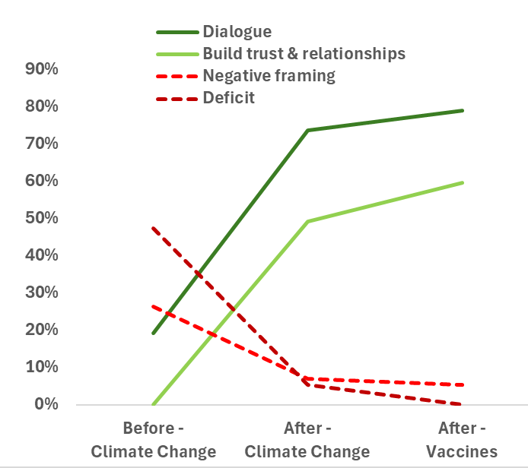
Worksheets
(n = 57)
Pre
Post
Vaccines
Notes:
Researchers analyzed student worksheets and coded for whether students were using the dialogue approach and, specifically, whether they intended to build trust and relationships since research shows this is so important for reducing conflict. This is what we found.

Slide 30
Worksheets
(n = 57)
Pre
Post
Vaccines
Few students used effective communication approaches
Notes:
Before instruction, very few students used these communication approaches.

Slide 31
Worksheets
(n = 57)
Pre
Post
Vaccines
Notes:
We also looked at whether students were using the deficit approach and specifically whether they were using negative framing since this could increase conflict.

Slide 32
Worksheets
(n = 57)
Pre
Post
Vaccines
More students used ineffective communication than effective
Notes:
We saw that before instruction, almost half of student took a deficit approach to their communication. But what about after instruction?

Slide 33
Worksheets
(n = 57)
Pre
Post
Vaccines
*all pre-post differences, p < .05
Effective strategies increased, ineffective decreased
Notes:
We saw a pretty dramatic change.
Effective strategies were now used by the majority of students and ineffective strategies decreased to almost zero.

Slide 34
Worksheets
(n = 57)
Pre
Post
Vaccines
*all pre-post differences, p < .05
Effective strategies increased, ineffective decreased
Effective communication transferred to a new topic
Notes:
Further, we saw a transfer to communication about vaccines, meaning that this instruction may have an impact beyond one topic.

Slide 35
Impacts of communication instruction, months later
Students still recognized their roles as boundary spanners
Students recognized the challenges of cultural competence
Religious differences
Political differences
Generational differences
22 MTSU biology students who received communication training
Students described that their science communication perceptions and experiences changed after instruction
Dee, before instruction perceptions:
Dee, after instruction experience:
But what about their actual communication experiences?
Did the instruction change that?
“I just kind of thought if you show everybody the facts and the logic, they're gonna get it...they'll just accept they’re wrong. So obviously that's not true, but that's what I thought good science communication was, is if you just have an infographic or solid logic, people will understand.”
"I was able to find more common ground with [my father]…I was able to bring climate change into an issue that he does care about and I was able to talk to him about it from a stance of his shared beliefs…even if we aren't going into all of the science and facts about climate change…we can still have effective communication..."

Slide 36
Feedback and Questions
Write any questions or feedback you have about class today.
It is anonymous so you don’t need to include your name!
I will respond to your feedback and questions next time!
3 minutes

